Slide 1
TOLL GATE SYSTEM
Submitted by
VARSHINI.S (2116210701302)

Slide 2
ABSTRACT
The Toll Gate System project automates toll gate operations using an Arduino microcontroller, an ultrasonic sensor, and a servo motor. When a vehicle approaches within a certain distance, the ultrasonic sensor signals the Arduino, which then activates the servo motor to open the gate. After the vehicle passes, the Arduino signals the servo motor to close the gate and resets the system. This setup, involving a breadboard and jumper wires for connections, increases efficiency by reducing manual intervention, minimizing wait times, and enhancing traffic flow management at toll gates.

Slide 3
INTRODUCTION
The Toll Gate System project automated toll booth operations using an Arduino microcontroller, ultrasonic sensor, and servo motor, connected via a breadboard and jumper wires. When a vehicle approaches, the ultrasonic sensor detects it and signals the Arduino, which activates the servo motor to open the gate. After the vehicle passes, the gate closes automatically, resetting for the next vehicle. This automation reduces human intervention, enhances efficiency, relieves traffic congestion, and ensures a smoother flow at toll plazas. Utilizing low-cost, widely available components, this system offers a practical and effective solution for modernizing toll collection.

Slide 4
LITERATURE SURVEY
[1] The automated toll collection system is a relatively recent piece of technology that has the potential to collect tolls in a manner that is both more efficient and expedient. It is an excellent alternative to the requirement of having to wait for a considerable length of time at manual toll plazas. A toll collection system that is based on RFID technology was built with the help of the Raspberry Pi.
[2] Transportation technology plays a vital role in people's lives, one of which is trains. The role of transportation has many positive impacts, but there are also many other negative impacts, one of which is an accident due to the manual operation of the rail junction gate. This work aims to build an automatic system that can control train gate junctions without an operator and sense based on train schedule with an additional sensor for detection of a train passing .

Slide 5
EXISTING TECHNOLOGY
The existing toll gate system uses an Arduino-based setup with an HC-SR04 ultrasonic sensor and an SG90 servo motor to automate gate operations. When a vehicle approaches, the ultrasonic sensor detects it and signals the Arduino to open the gate by powering the servo motor. Once the vehicle passes, the gate closes automatically. This system, comprising an Arduino board, breadboard, and jumper wires, offers a cost-effective alternative to traditional manual toll systems and expensive technologies like RFID or ANPR, reducing the need for human intervention. However, while economical, it may face challenges in terms of security and scalability compared to more sophisticated models.

Slide 6
PROPOSED TECHNOLOGY
The proposed toll gate system automates barrier operations using an Arduino, SG90 servo motor, and HC-SR04 ultrasonic sensor. When a car approaches, the sensor detects it and signals the Arduino to open the gate. After the car passes, the gate closes automatically. This cost-effective system, ideal for small to medium-sized toll operations, reduces reliance on manual labor and expensive technologies like RFID and ANPR, speeding up vehicle processing and lowering operational costs. It also offers potential for enhancements such as integrating payment systems and additional sensors for improved accuracy.

Slide 7
HARDWARE AND SOFTWARE REQUIREMENTS
HARDWARE REQUIREMENTS
• Arduino
• Ultrasonic Sensor
• Power Supply
• Jumper Wires
• Servo Motor
• Breadboard
SOFTWARE REQUIREMENTS
• Arduino IDE

Slide 8
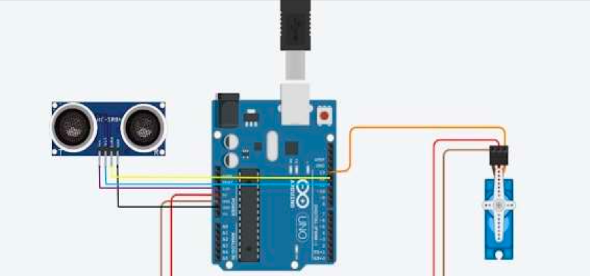
CIRCUIT DIAGRAM

Slide 9
CONCLUSION
Implementing an Arduino-based toll gate system is a cost-effective way to increase efficiency by using ultrasonic sensors to detect cars and servo motors to control gates, eliminating the need for manual operations. This approach addresses inefficiencies and high costs of traditional toll systems, providing a simple yet effective solution. Future improvements could include adding RFID readers for electronic tolls, using solar panels for sustainability, developing mobile apps for real-time monitoring and control, and employing machine learning to predict peak traffic times and optimize gate performance.Implementing an Arduino-based toll gate system is a cost-effective way to increase efficiency by using ultrasonic sensors to detect cars and servo motors to control gates, eliminating the need for manual operations. This approach addresses inefficiencies and high costs of traditional toll systems, providing a simple yet effective solution. Future improvements could include adding RFID readers for electronic tolls, using solar panels for sustainability, developing mobile apps for real-time monitoring and control, and employing machine learning to predict peak traffic times and optimize gate performance.

